Slide 1
Student Management System
FA20-BSE-096(Komal Khizar)
FA20-BSE-110(Kumail Imran)

Slide 2
Introduction
The student management system can handle the details about a student.
The details include Student personal details ,course details ,academic details etc.
Student management system is an automated version of manual student management system.
By using this system we can save the data of any student in any organization.

Slide 3
Names of Module
Admin Module(FA20-BSE-096)
Student Module(FA20-BSE-110)
Login\Signup Module(FA20-BSE-110)

Slide 4
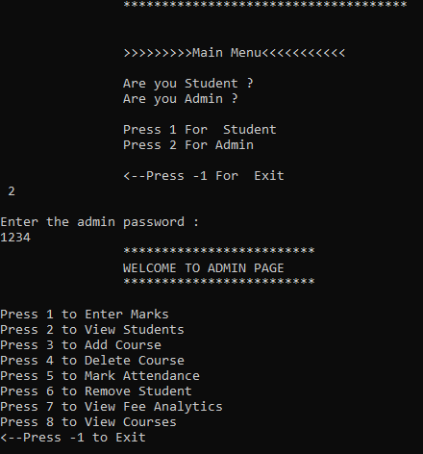
Names of Module(Admin)
Admin Module
Enter Marks
View Students
Add courses
Delete Course
Mark Attendance
Remove student
View Fee analytics
View Courses

Slide 5
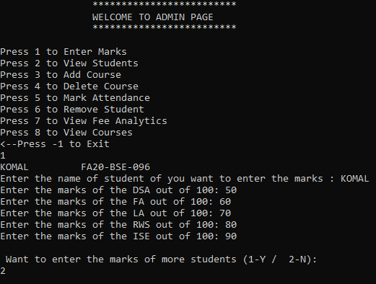
Enter marks
In this system admin can enter marks of any student of their registered courses .
Admin can find student by his name and then enter his/her marks.

Slide 6
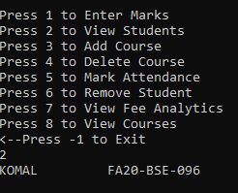
View student
Admin can view students that are registered.

Slide 7
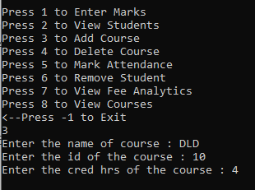
Add courses
Admin can add course by entering name ,id and credit hours of that course.

Slide 8
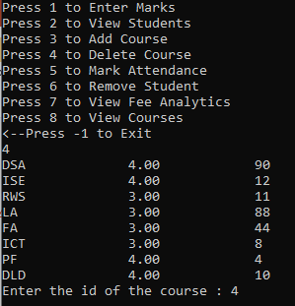
Delete course
Admin can delete course by entering the id of that course.

Slide 9
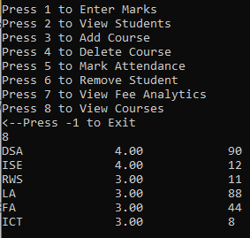
View courses
Admin can view all the courses that can be registered.

Slide 10
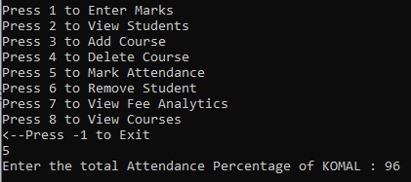
Mark attendance
Admin can mark attendance of each student that are registered.

Slide 11
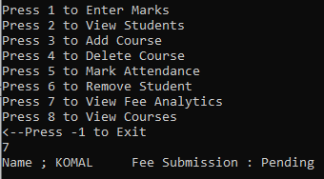
View fee analytics
Admin can view fee status of every student.

Slide 12
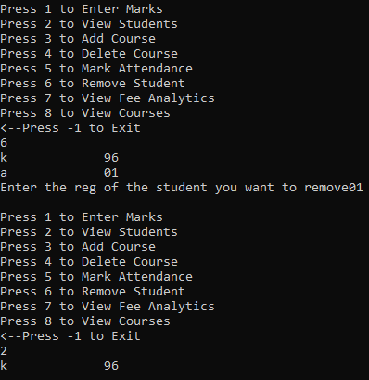
Remove student
Admin can remove any student by entering his/her registration.

Slide 13
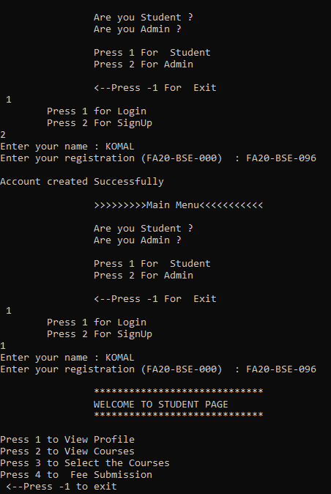
Names of Module(Student)
Student Module
View Profile
Select Courses
View Courses
Fee Submission
Signup\Login Module
Register new Student Module
Sign in module

Slide 14
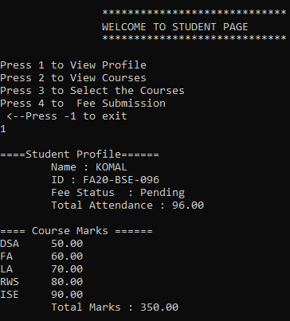
View profile
Student can view profile in which all detail about courses ,marks ,attendance ,total marks and fee submission is provided.

Slide 15
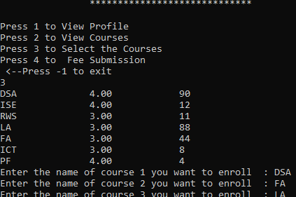
Select courses
Student can select 5 courses from given courses .

Slide 16
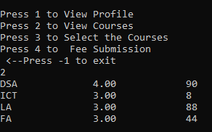
View courses
Student can view courses in which he/she is registered.

Slide 17
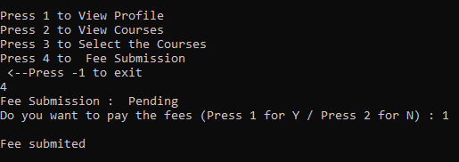
Submission of fee
Student can submit fee on this system online and can check fee status.

Slide 18
Usage of Various Data structures
Linked List
Array
Reasons of using Linked list
Reasons of using Linked list is because it is easy to use linked list instead of array because of time complexity and searching is easy.
Actually we use collection of different types that’s why we use linked list.
Insertion and deletion is easy in linked list as we don't have to manage to index each time.
As its size grows and shrink automatically.

Slide 19
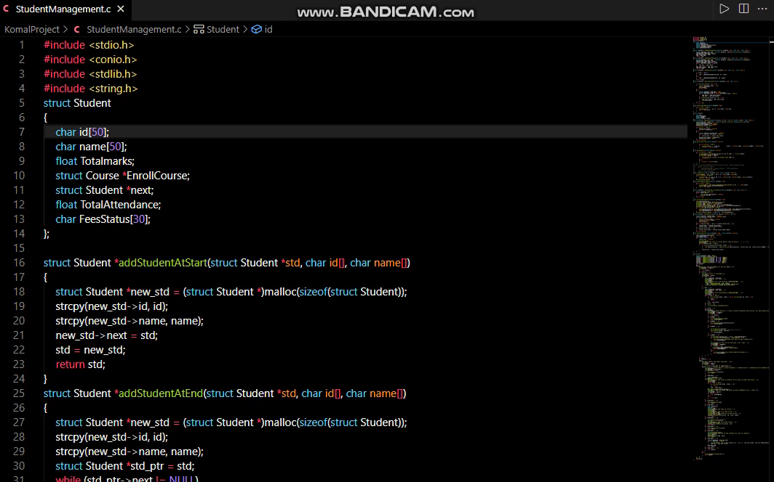
Video of output screen

Slide 20
THANK YOU

